Slide 1
Video Recoloring via Spatial-Temporal Geometric Palettes
Zheng-Jun Du Tsinghua University, Qinghai University
Kai-Xiang Lei Tsinghua University
Kun Xu Tsinghua University
Jianchao Tan Kwai Inc.
Yotam Gingold George Mason University
Notes:
Hello everyone, I am Zhengjun Du from Tsinghua University. In this talk, I will introduce a spatial-temporal geometry-based approach to video recoloring.

Slide 2
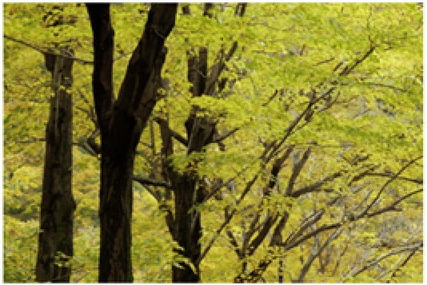
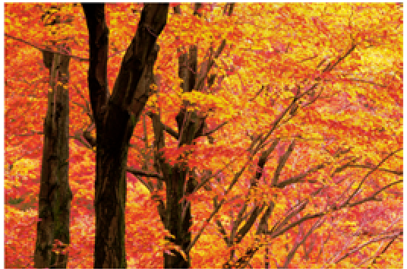
Motivation
Palette-based image recoloring is intuitive and simple
image
palette
edited palette
recolored image
Can we extend it to recolor a video?
Input video
Palette
Recolored video
Challenge: The palette can change over time!
Notes:
Palette-based image editing is a recent paradigm for color adjustment. These approaches extract a palette with several salient colors from the image to represent the color distribution. The palette provides users with an intuitive set of handles to edit the image. And users can easily recolor the image by modifying its palette colors.
The natural idea is that can we extend the palette-based image recoloring to video editing?
The key challenge is that the palette should capture color changes in the video, so the user can edit them. The palette should also allow the user to introduce color changes over time.

Slide 3
Related work
Clustering-based methods
[Chang et al. 2015; Nguyen et al. 2017; Zheng et al. 2017]
Palette-based image recoloring using color decomposition optimization [Zheng et al. 2017]
Notes:
As for palette-based image recoloring, there are two main kinds of approaches.
The first is based on clustering, these methods employ k-means clustering of pixels to extract palette colors, these palettes capture the dominant colors in an image. And then decompose pixel into linear combination with the palette, which enables efficient image recoloring.

Slide 4
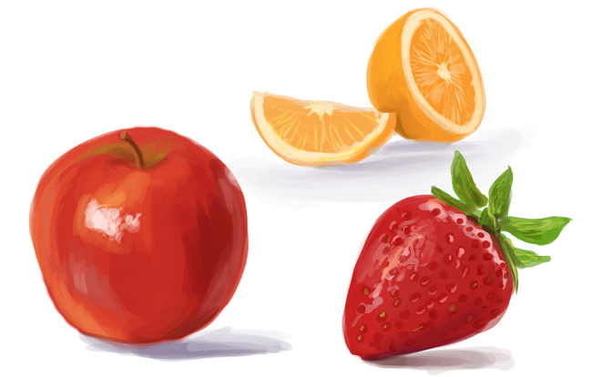
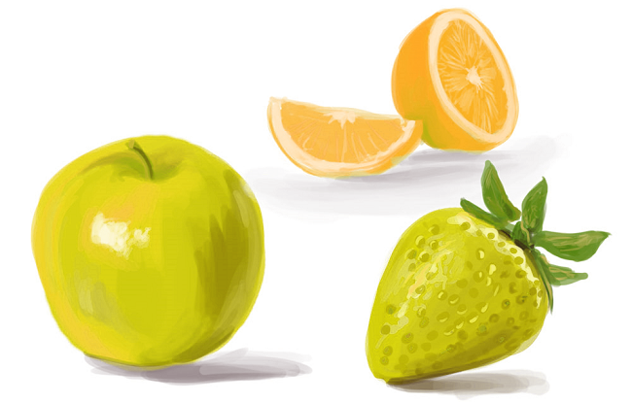
Related work
Convex hull-based methods
[Tan et al. 2017; Tan et al. 2018; Wang et al. 2019]
RGB image I
Palette(convex hull)
Recolored image
An improved geometric approach for palette-based image decomposition and recoloring [wang et al. 2019]
Notes:
The second is based on convex hull. These methods extract palettes from images based on simplified RGB convex hulls. The simplified convex hull has a simple geometric shape, and its vertices intuitively represent palette colors. Pixel colors can be naturally represented as linear combinations of palette colors. Its linear nature makes the recoloring process intuitive, efficient and results in better recoloring quality.

Slide 5
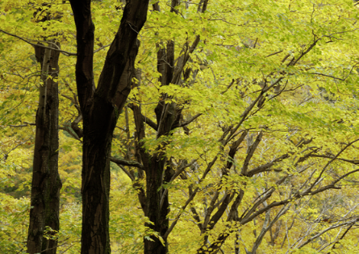
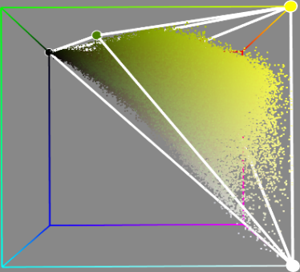
Our main idea
Extend the convex hull-based image recoloring to video scenarios
RGB image
Palette (RGB 3D geometry)
RGBT video
Palette (RGBT 4D geometry)
Notes:
Geometry-based image recoloring employ a 3D RGB convex hull to extract the palette.
Similarly, our main idea is to extend this method to video scenario, and employ a 4D RGBT geometry to extract the video palette.

Slide 6
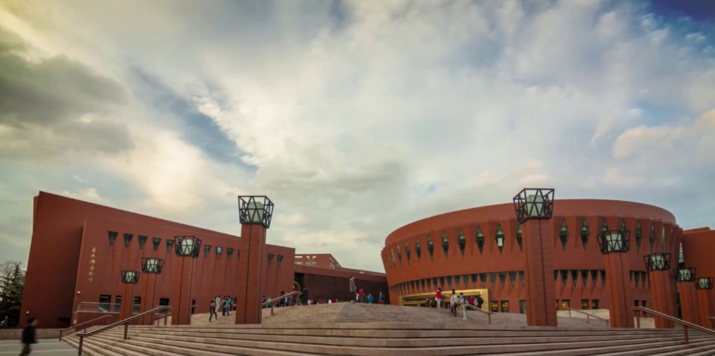
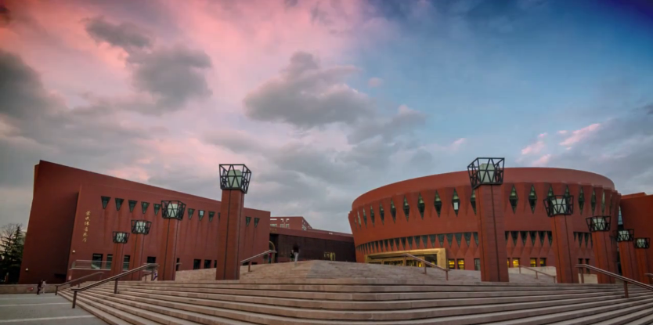
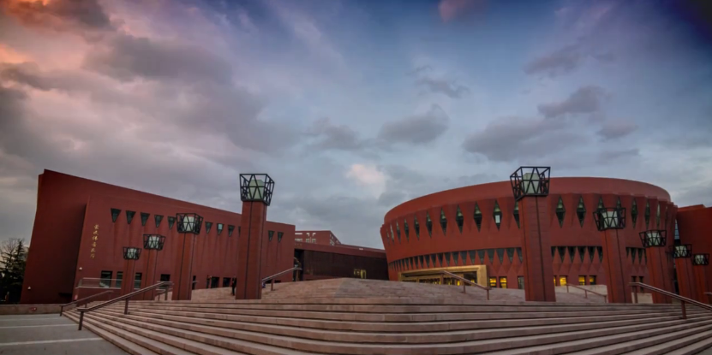
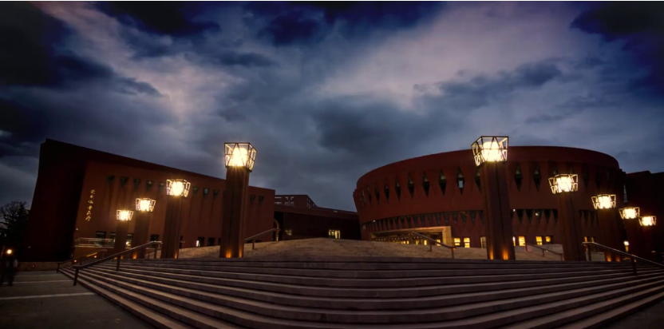
Choices of RGBT 4D geometry
t₀
t₁
t₂
t₃
t
Input video
RGB
space
Better compactness
Simpler topology
RGBT skew polytope
Notes:
The last approach is to build an RGBT skew polytope.
It should be noted that, unlike with regular polytope, skew polytope allows non-planar [ˈpleɪnə(r)] faces.
Compared with the first three shapes, the skew polytope not only has better compactness, but also has simple topology[tə'pɒlədʒɪ].
Therefore, we employ a 4D RGBT skew polytope to extract the video palette.

Slide 7
Output the geometric palette
0
1
2
3
t
Refined
skew polytope
Geometric
palette
Notes:
The resulted 4D skew polytope corresponds to the generated geometric palette.
So far, we have already extracted the geometry palette from a given video, next we show how to use it to recolor the video.

Slide 8
Results
Notes:
Here we show some video recoloring results.
In this video, we make the mountain gradually change from spring to autumn.

Slide 9
Results
Notes:
In this video, we make the cloud color changes from gray to red.

Slide 10
Results
Notes:
In this video, we perform more color variations to the cloud and the mosque to make them more colorful.

Slide 11
Results
Notes:
In this video, we make the light color gradually changes from green to yellow, and the morning looks warmer.

Slide 12
Conclusion
We proposed the first palette-based video recoloring
Our method produces natural, artifact-free recoloring
Notes:
In conclusion, we propose the first palette-based video recoloring, and our method produces natural, artifact-free recoloring.

Slide 13
Thank You!
Contact Information:
Zheng-Jun Du: duzj19@mails.tsinghua.edu.cn
Kai-Xiang Lei: leikx18@mails.tsinghua.edu.cn
Kun Xu: xukun@tsinghua.edu.cn
Jianchao Tan: tanjianchaoustc@gmail.com
Yotam Gingold: ygingold@gmu.edu
Project page
Notes:
That's all my presentation.
Thanks for your attention!
If you have any questions, please feel free to contact us.

